Slide 1

Pet Loves Project
Making the perfect match between human and pet

Slide 2
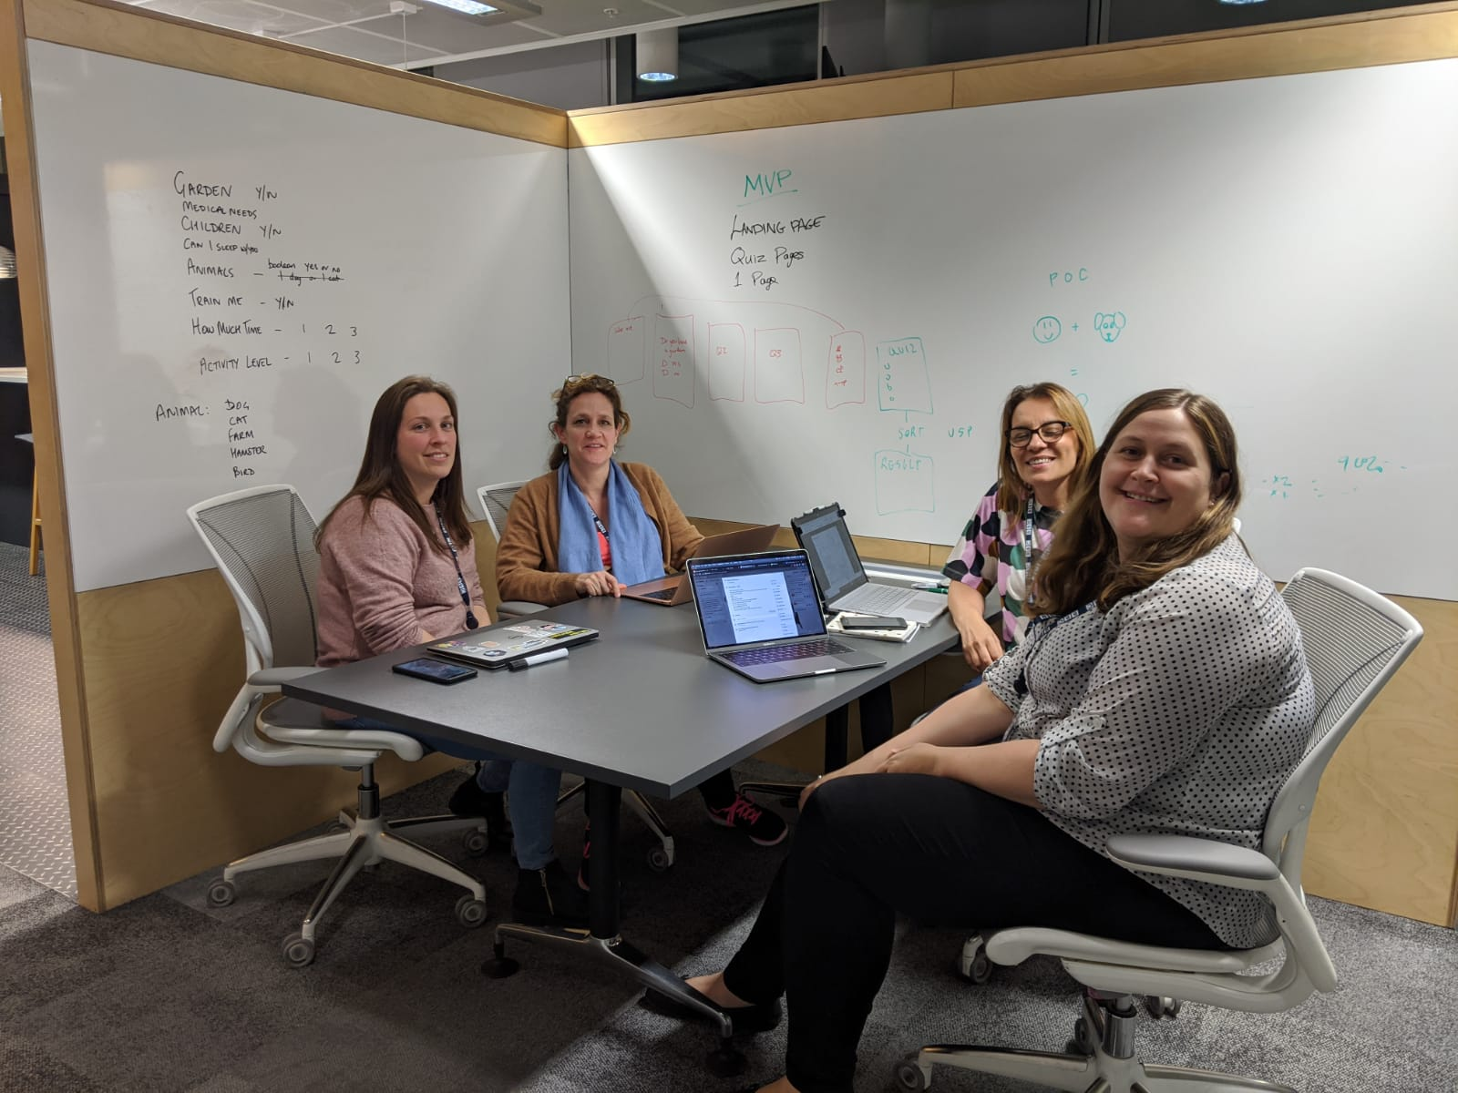
The Team!
Amelia
Laura
Jyoti
Lorna

Slide 3
Intro - Why, How What (the problem our app solves)
We all share a deep love of animals and had a geniune desire to do something to contribute towards the plight of rescue animals. Helping to match them with their perfect owner.
We started off with an idea of an app that match pets with their ideal human.
The first thing we needed to do was to decide how we were going to go about this taking into account the limited time scale and bearing in mind Minimum Viable Product and Proof of Concept.

Slide 4
The Problem our idea solved
We wanted our app to ask questions of potential owners to measure their suitability to own a particular pet. We wanted this to be done through a filtering process in the form of a quiz
How we worked as a team
A series of in person, zoom, google hangouts and whatsapp and Slack messaging.
What did we want from our product?

Slide 5
How we worked (communication, responsibilities)
Scrum, Kanban, etc

Slide 6
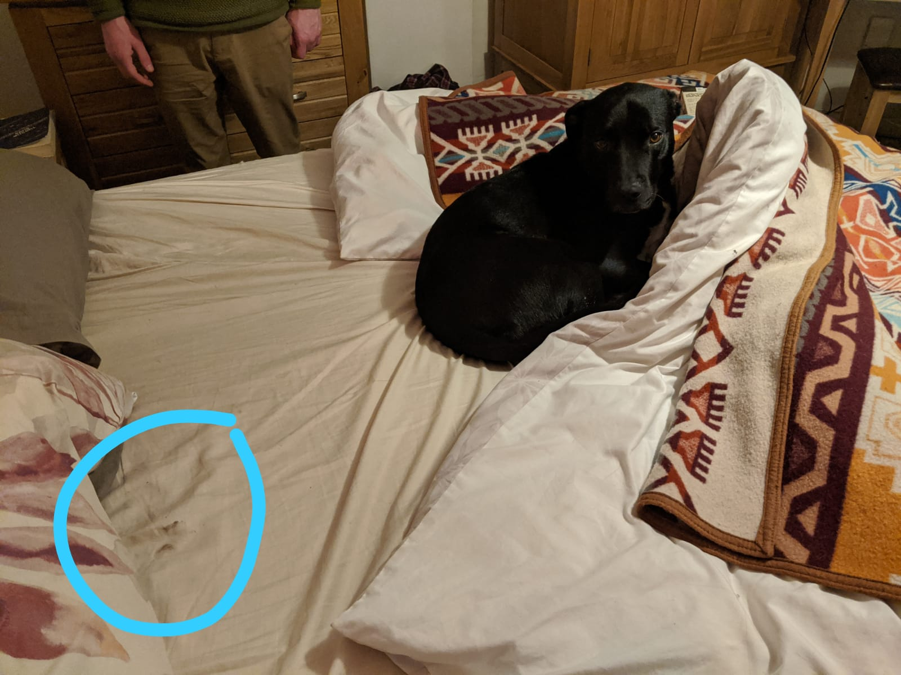
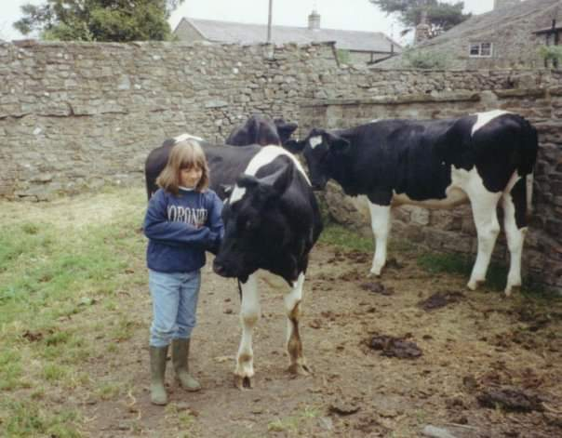
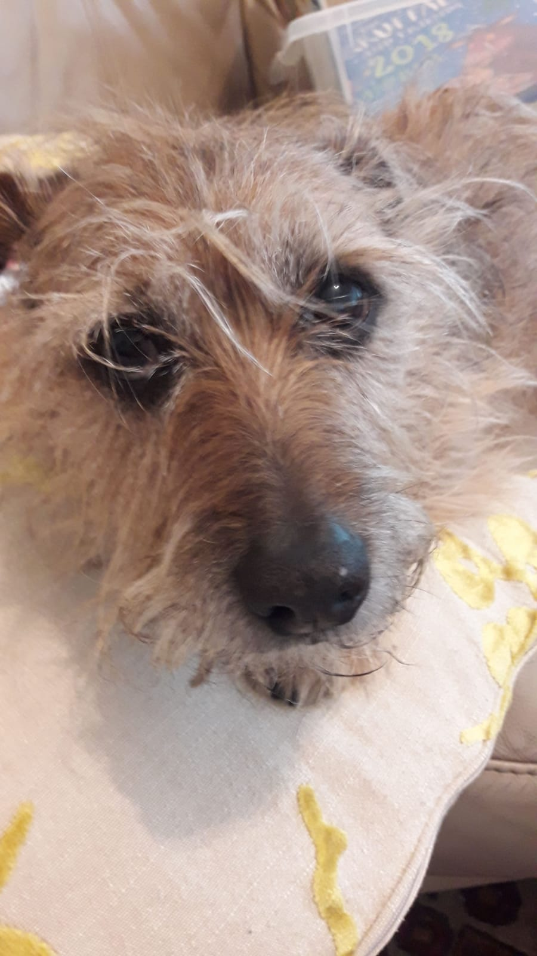
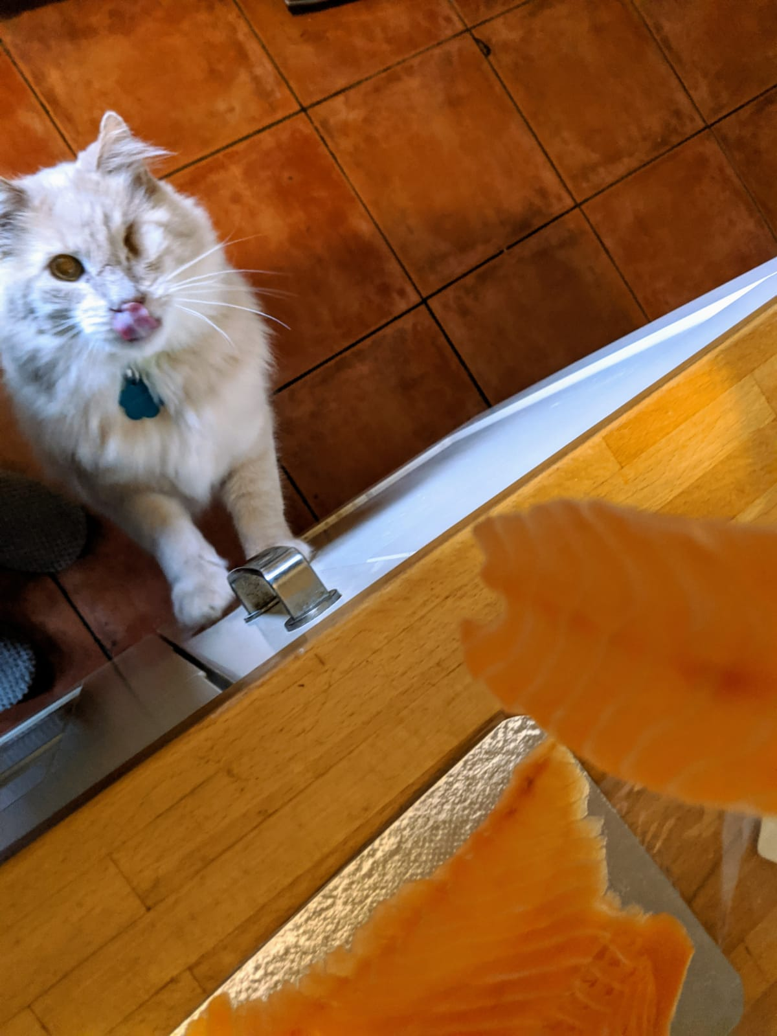
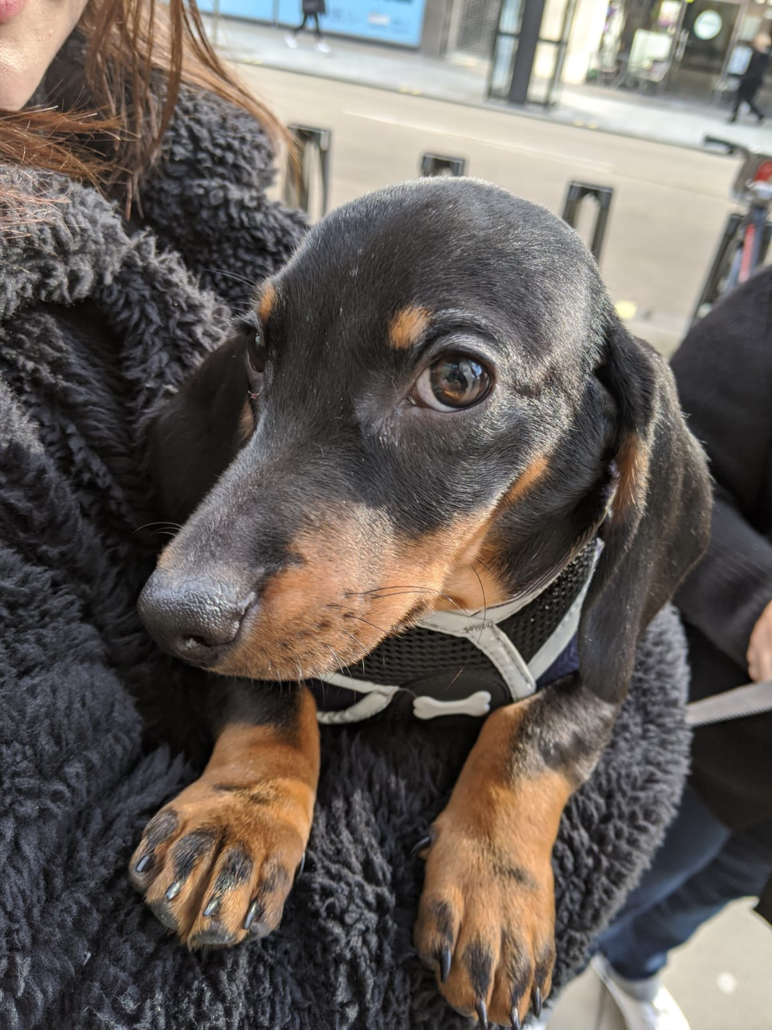
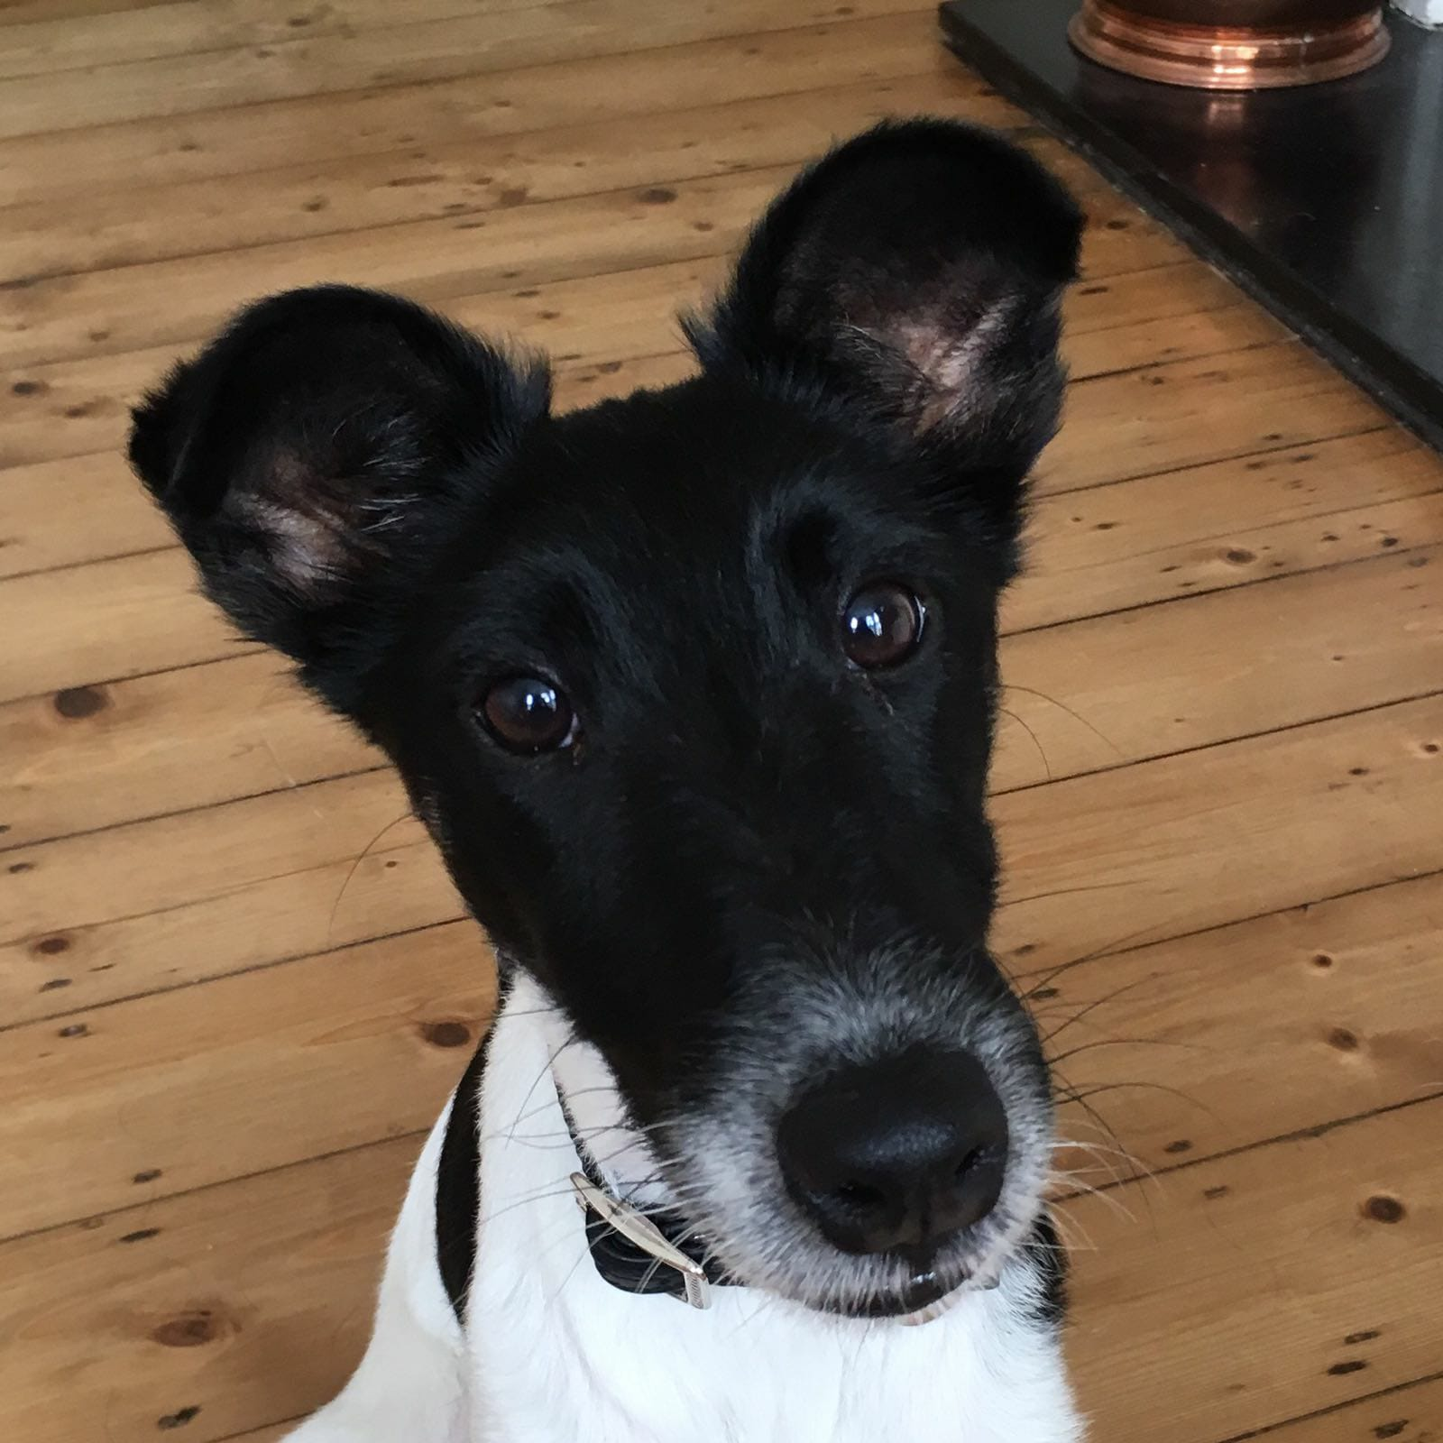
Inspiration

Slide 7
Concept/ Structure
Look and Feel
We wanted the site to have a friendly and warm feel about it so used soft colours and a cute logo in a warm pink colour.
(Put image of logo here)

Slide 8
What we did
Processes
We wanted to structure the app so that the landing page was a quiz asking some basic boolean questions of potential pet owners, such as:-
Do you have a garden?
How much time do you spend at home?
Do you have children?
Followed by a question, ‘what is your level of activity?’, with a slider question where you would place on the slider your level of activity. This would also help to determine the potential pet owners suitability for any particular pet.
This would then bring up and array of ‘pet cards’pulled from the database with a ‘Learn More’ button that when pressed would give individual information on each potential pet.

Slide 9
Work Process
With a mixture of stand up meetings in person and over Zoom, single, pair, trio and quad programming,we have worked on the shape and structure of the app.
This included:-
Setting up a Trello project where we inputted all of the resources, tasks, and materials we needed to complete the project.
Setting up and account on Github
Setting up a database on AWS LAMBDA using Mysql
4 topics to talk about
Why and how
What we did
Processes
Inutting all aspects of the project into Trello with a combination of virtual and in person stand up meetings we collaborated in single, pair, trio and quad programming.
Jyoti- you mentioned set.state - prevent default asynchronous state
Console logs not sharing anything
The first weekend was a major challenge.
We knew where we wanted to be but we didn’t know how to get there.
We were very new to React and Bootstrap which made the project all the more challenging
We needed to define our minimum viable product. After having initially many ideas going off in different directions we realised that we really needed to pare down the idea.
Problems
Database access problems
Navigation through website without React router
Research
Text block - How many animals are re homed every year
We took our research from real analysis and statistics
What would our optimum product look like?
Links to different websites
Maybe we can have one last filter by category for animal type. Checkboxes mvp and then I can try to make the clickable image buttons that we dreamed about from the beginning.
For the purposes of the demo, we can show two routes through the questions:
Has garden = Yes
Has children = Yes/NoActivity level =
Has garden = Yes
Has children = Yes/No
Activity level = Couch potato
Time at home = Don't leave the home
=> DOGS
Has garden = No
Has children = Yes
Activity level = Couch potato
Time at home = Away often - option 3 on the slider, not working full-time
=> BIRDS and SMALL FURRIES
For the first example, we can select those options and display the results. Then do a quick toggle of the "Has children = Yes/No" to show that it filters dogs based on if they like children.
Create a backend API that accepts quiz answers in the form of JSON such as
{
answers: [
{
"questionOne" : "no"
}
]
}
Then you would pass that information on to database by constructing a query
SELECT * FROM pet WHERE pet.children_ok = ?
2. Create a frontend that allows just one question and that question is 2 distinct values (yes/no)
Once you've got that working, then introduce complexity of multiple questions on the frontend and handling of multiple questions on the backend
20:24
This is a fairly ok tutorial on concepts
http://carinyperez.com/create-quiz-react/ (edited)
Cariny Perez
Create a Quiz with React
In this tutorial you will learn how to create a quiz using the React framework.
10 Oct 2017
Wednesday, 11 March
axios
.get('https://srtcnv0e2e.execute-api.eu-west-2.amazonaws.com/dev/pets/', {
params: {
hasGarden = this.state.answers.hasGarden
}
})
Csv file on database
Proof of concept

Slide 10
Technology Used
We used a range of technology including:-
Scraper tool
Frame works - React/Javascript/ Serverless
Trello
Github
VSCode
In Vision
Amazon Web Services
Mysql database/ Amazon web services (LAMBDA)

Slide 11
Blocks/ Challenges

Slide 12
Future roadmap of project

Slide 13
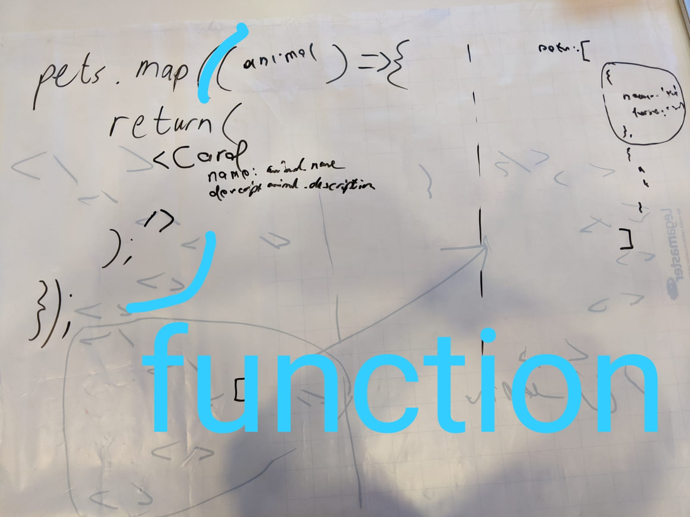
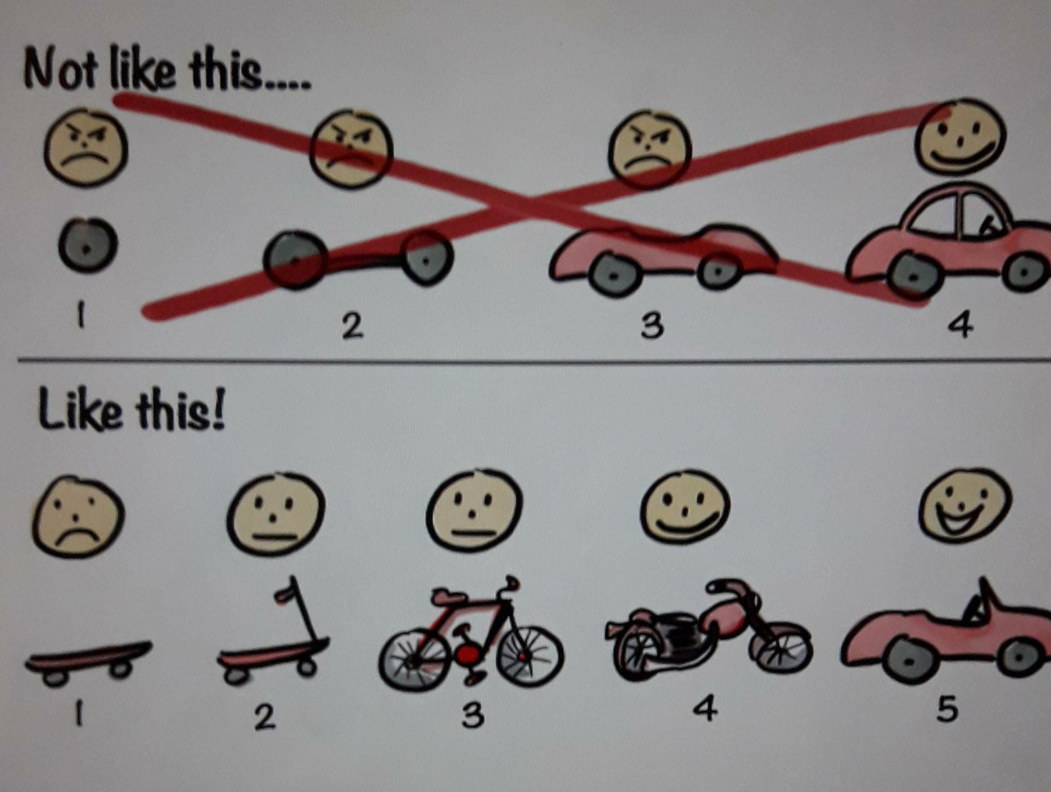
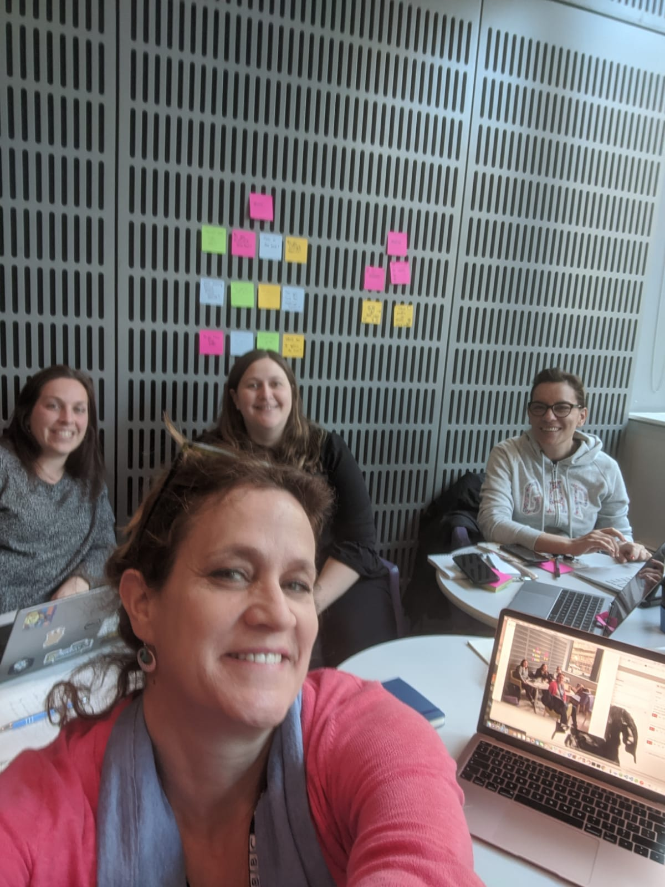
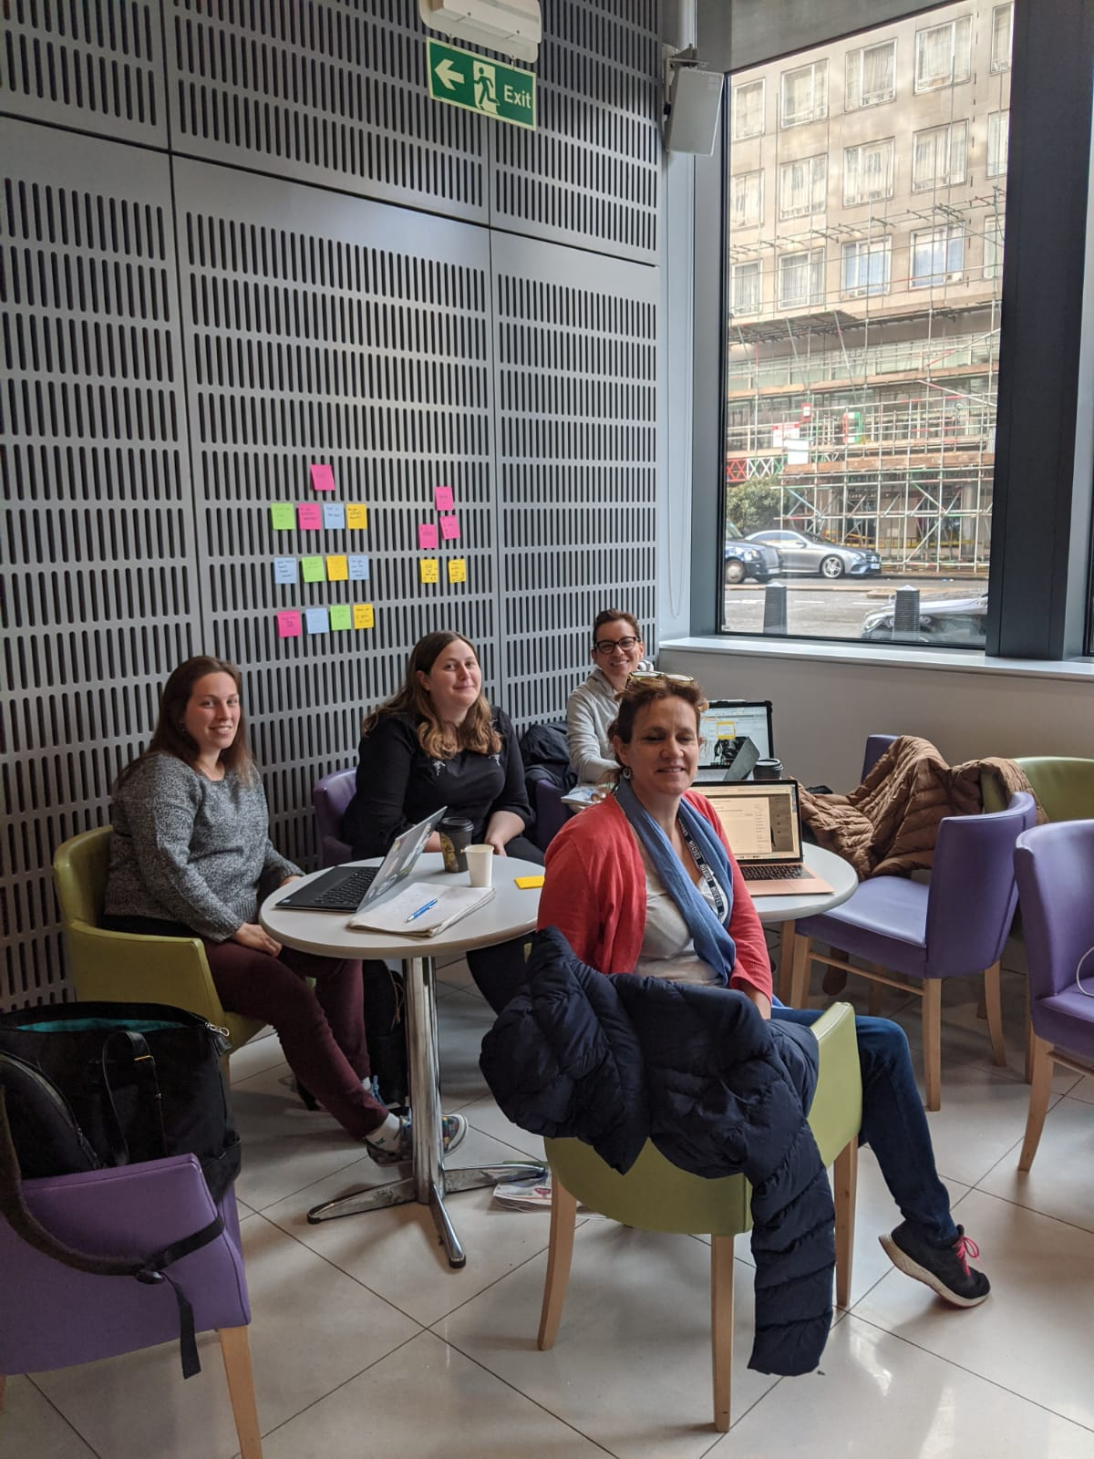
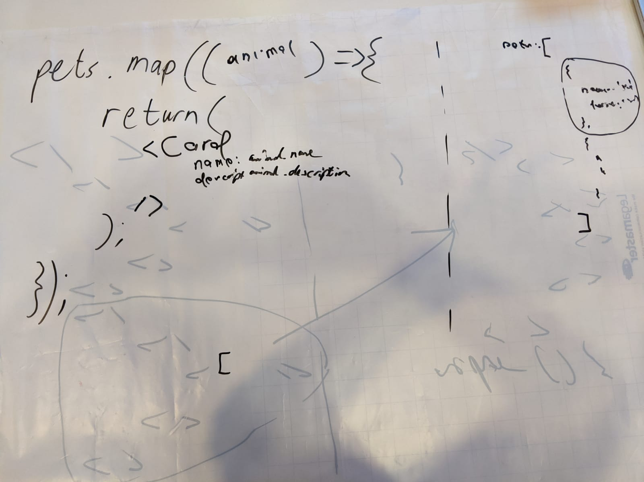
Whiteboard Discussions

Slide 14
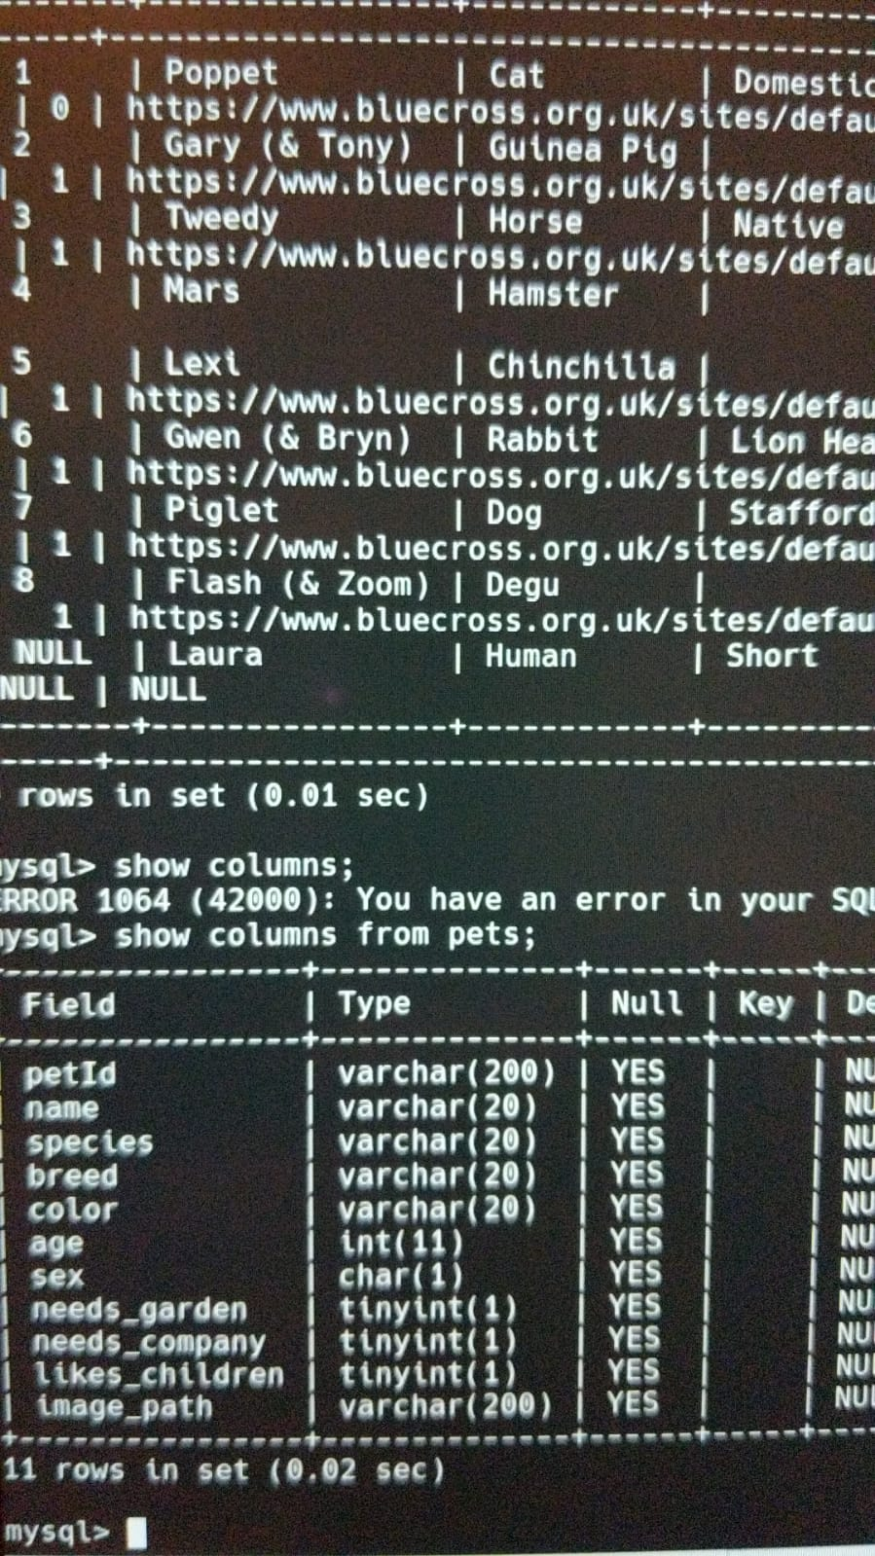
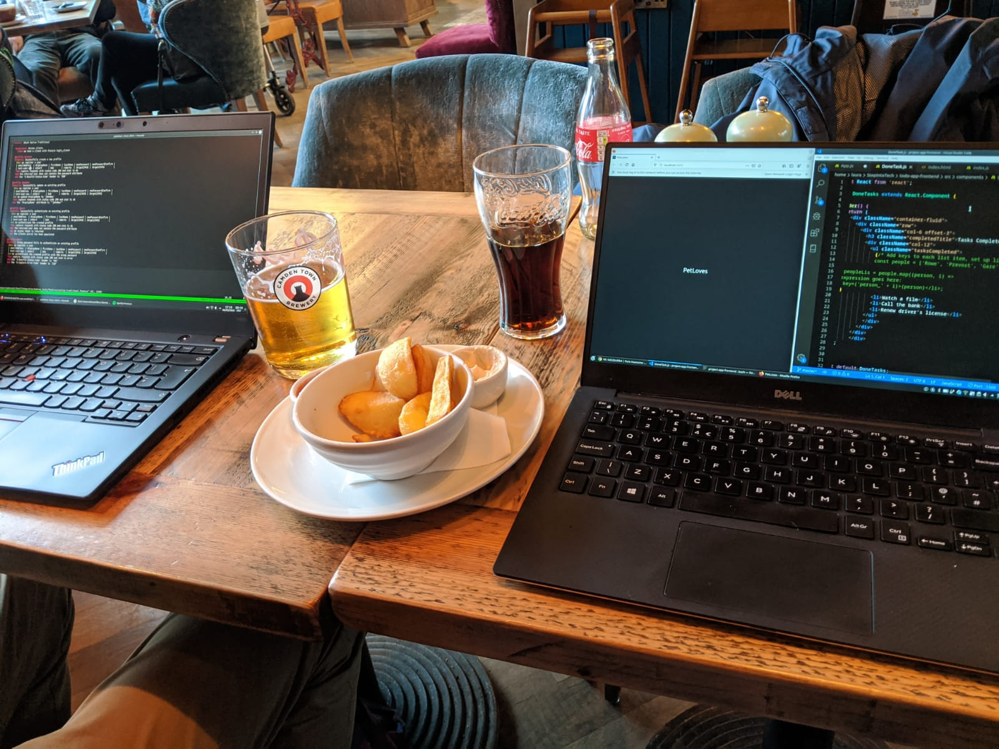
Research

Slide 15
Research
Battersea Dogs Home
https://www.battersea.org.uk/?gclid=CjwKCAjwgbLzBRBsEiwAXVIygI4J4ZSZX6-P5c40rajtzDheXah2J5Nq13wbY18RsTcZK6US3nydkxoC2jUQAvD_BwE
PDSA
https://www.pdsa.org.uk/?_$ja=tsid:67827|cid:258761070|agid:20225634390|tid:kwd-90377080|crid:294826746416|nw:g|rnd:689055166402275185|dvc:c|adp:|mt:e|loc:9045889&gclid=CjwKCAjwgbLzBRBsEiwAXVIygNLvyOhANwyFTG-IXqlDjm6TFekid1w9fp0cdTi0DWnR1GvDnytUXhoCgbYQAvD_BwE
Dogs Trust
https://www.dogstrust.org.uk/rehoming/?gclid=CjwKCAjwgbLzBRBsEiwAXVIygL1cK3OWJR2YcviJWbah0PIaAB0_8phRiOxDatclzuRAERLfx_JQphoCn3UQAvD_BwE&gclsrc=aw.ds

Slide 16
Demo of the app (What)
Show two features

Slide 17
Project review

